Slide 1
Inheritance and Advanced OOP Features
Arif Istiake Sunny
sunny1509006@gmail.com

Slide 2
Agenda
Intro to Inheritance Single Inheritance Hierarchical Inheritance Multilevel Inheritance Multiple Inheritance Method Overloading Method Overriding Encapsulation
Polymorphism

Slide 3
Intro to Inheritance
Inheritance allows us to define a class that inherits all the methods and properties from another class.
Parent class is the class being inherited from, also called base class.
Child class is the class that inherits from another class, also called derived class.
Parent class
Child class
class Person:
def __init__(self, fname, lname):
self.firstname = fname
self.lastname = lname
def printname(self):
print(self.firstname, self.lastname)
class Student(Person):
pass
#----------------------------------
y = Student("Abul", "Hossain")
y.printname()

Slide 4
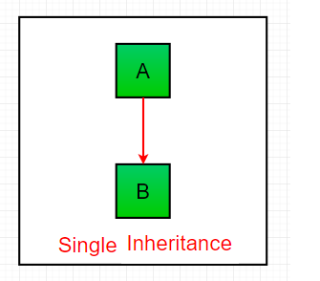
Single Inheritance
class A:
def display1(self):
print("This is class A")
class B(A):
def display2(self):
print("This is class B")
objB = B()
objB.display1()
objB.display2()

Slide 5
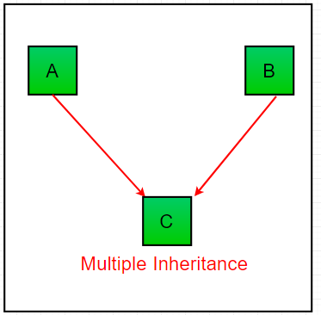
Multiple Inheritance
class A:
def display1(self):
print("This is class A")
class B:
def display2(self):
print("This is class B")
class C(A, B):
def display3(self):
print("This is class C")
objC = C()
objC.display1()
objC.display2()
objC.display3()

Slide 6
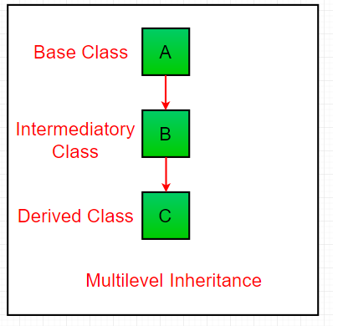
Multilevel Inheritance
class A:
def display1(self):
print("This is class A")
class B(A):
def display2(self):
print("This is class B")
class C(B):
def display3(self):
print("This is class C")
objC = C()
objC.display1()
objC.display2()
objC.display3()

Slide 7
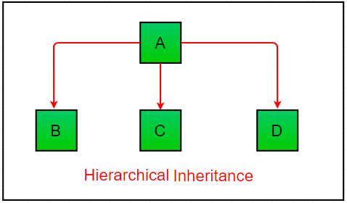
Hierarchical Inheritance
class Parent: # Base class
def func1(self):
print("This function is in parent class.")
class Child1(Parent): # Derived class1
def func2(self):
print("This function is in child 1.")
class Child2(Parent): # Derivied class2
def func3(self):
print("This function is in child 2.")
# Driver's code
object1 = Child1()
object2 = Child2()
object1.func1()
object1.func2()
object2.func1()
object2.func3()

Slide 8
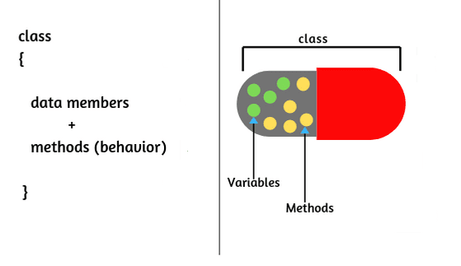
Encapsulation
Encapsulation in Python describes the concept of bundling data and methods within a single unit. So, for example, when you create a class, it means you are implementing encapsulation.

Slide 9
Polymorphism
Polymorphism is taken from the Greek words Poly (many) and morphism (forms). It means that the same function name can be used for different types.
#Built in Polymorphic function
print(len("Aksadur Rahman"))
print(len([10, 20, 30]))
#User define polymorphic function
def add(x, y, z=0):
return x+y+z
print(add(30, 20))
print(add(10, 30, 20))

